Slide 1
Notes:
This briefing PowerPoint accompanies the Faith and Police Together Briefing for Officers which can be viewed from the following link: https://vimeo.com/491197900/912dbfaebe
It is aimed at Neighbourhood policing teams however suitable for all front line staff and those involved in problem solving.

Slide 2
Learning Outcomes
Identify your Faith communities and what they do.
Develop meaningful engagement and partnerships with your faith communities.
Understand the potential of Faith communities in supporting the you in problem solving community issues.
Share best practice.
Notes:
At the end of this input you will be able to.
Identify your Faith communities and what they do.
Develop meaningful engagement and partnerships with your faith communities.
Understand the potential of Faith communities in supporting the you in problem solving community issues.
Share best practice.

Slide 3
ACC WILLIAMS West Yorkshire Police.
NPCC Lead for Religion and Belief.
https://vimeo.com/472531484/a7e0de7e4a
Notes:
Transcript of video 1m32s
I lead the NPCC for religion and belief and our focus is both internally but also externally. We look to encourage all our officers and staff in policing to bring their whole self to work and not leave their faith at the door. We have worked hard to ensure, that there are proper prayer facilities at work, time off can be taken for religious festivals and holy days and are uniform doesn’t cause offence wearer or the community. It continued to work hard with our faith-based staff support networks to ensure they have a voice and listen to. Externally, we are keen to work alongside all faith communities to ensure they feel secure valued and supported. We understand the link to faith-based hate crime and how it must be treated sensitively, investigated in line with victims wishes. In my own force of West Yorkshire, where we benefit from a very diverse community, we continue to work alongside all faith communities, who I have to say a most supportive and generous to policing and always offer a really common sense view, good resources, buildings and often a decent cup of coffee over a chat. I can’t thank them enough. Whilst 2020 has been a very difficult year for us all with Covid hopefully 2021 will be a bit smoother, I would encourage us all to continue to invest in one another and our faith communities, who I see as key to policing moving forwards.

Slide 4
The inclusion of Faith groups supports the College of Policing Neighbourhood Policing Guidelines issued in 2018 and assists specifically with Engaging Communities and Solving Problems. This briefing will also support officers working within Neighbourhood Policing to review their own approach towards effective relationships with Faith groups as partners in tackling Community issues together.
The links to the Guidelines from the College of Policing website can be found here: https://www.college.police.uk/What-we-do/Standards/Guidelines/Neighbourhood-Policing/Pages/neighbourhood-policing-guidelines.aspx
Engaging communities
Solving problems
Targeting activity
Promoting the right culture
Building analytical capability
Developing officers, staff and volunteers
Developing and sharing learning

Slide 5
A/Insp Marie Reavey Norfolk Police
National Lead for Faith + Police Together
https://vimeo.com/494042592/62e2b906b0
Notes:
Transcript of A/Insp Reavey
Hi, I am Marie Reavey and I am the national lead for FnP which aims to see strong partnerships being formed between the Police and their local Faith communities to help make safer communities for all.
Faith communities often engage with a large cross section of the population, they cover all the protected characteristics and many of them include black Asian and minority ethnic background communities. Some of those will be perhaps suspicious of the police and lacking in trust and confidence in the police. But over a period of time, if we work with our faith communities we can help break down those barriers and build trust and confidence within our communities. Some places of worship connect with well over one thousand people a week through their weekly services social action and out reach initiatives. Many people who come into contact with faith communities will be vulnerable and many will never have any contact with eth police. They are a great source of intelligence and they know what is going on in your communities.
There is some fantastic work going on between the police and the faith communities and we really want to encourage the sharing of that best practice. You can do that on the neighbourhood policing knowledge hub.

Slide 6
DCC Paul Netherton – Introduction
https://vimeo.com/462636291/d133d7c195
Notes:
Transcript of Video from Paul Netherton
My name is Paul Netherton I’m the deputy to Constable Devon and Cornwall police, I’m also the president of the Christian police Association. Over the last 2 ½ years I have been working with some faith leaders and police forces across the country promote faith and police together. Faith and police together is an initiative designed to bring the police service closer to faith communities, who are then able to help the police deal with some of the challenges in society. When we started the challenges were mainly around things like loneliness and isolation but as the years have gone by we’ve picked up area such as gang violence and youths carrying knives. How can faith communities, churches, synagogues, mosques work with the police service to engage people to try and solve the problems and allow the police service to access the huge social capital that faith groups can provide.
We saw how just allowing church and faith groups getting them to open their doors to the police service, created conversations and those conversations raised awareness of problems within communities and that simple conversations let to some fantastic results, where we could motivate people to get involved and solve the problems. If you are a police officer telling faith groups these are the problems as the police understand it and saying to them how can you help us solve these problems.
We already have something fantastic schemes in place and running for instance Street pastors and Street Angels are two well-known organisations that are working with the police to help around things like the night-time economy. In Devon and Cornwall we said okay how can we take that idea for a night-time economy and bring it into the schools so it’s dealing with bullying and isolation and challenges within the school environment so we develop school pastors. We have also used chaplaincy is a really effective way of not only supporting the police and the welfare of staff within the organisation the traditional role of chaplains, but also to used those connections to reach out into communities and broker conversations trying to encourage faith groups to help the organisation and the challenges that policing face.

Slide 7
Paul Blakey MBE Founder of Street Angels & Christian Nightlife Initiatives Network
https://vimeo.com/463075664/e6316758c3
Notes:
Transcript of video 2m16s
Hello Paul Blakey hear the founder of Street Angels and Christian Nightlife Initiatives Network. I remember back in 2005 when I working with the churches together in Halifax had this idea to open a cafe as a safe place dropping around those who become vulnerable within our night time economy, when I shared this idea with the town centre police Sergeant Dave Aptsey he got so excited and meeting within a week later he offered the support the resources the backing and an even finance from the police in Colderdale to help make our idea of reality. We launched two weeks later and amazingly so many people turned up for our safe place cafe that was unrealistic just to run a safe place dropping so the whole idea and ministry of Street Angels was born with the full support and backing of the town centre police team, it went on to work And violent crime in our town centre reduced by 42% within the first 12 months that the project run. The only thing that the police were doing differently was working in partnership with other organisations and safe people patrolling the town centre at a time when it was very much needed. You know the problems, the issues the dynamics of any place require more than just one agency response it needs partnership working and the faith Communities can be very much at the heart of that partnership working. As has been modelled through Street Angels and various other organisations. So can I encourage you as the police To look for Natural links with your faith communities. We often have the money we often have the manpower the people power, the resources the strategic way of working All those things that could help make a project successful.
So I endorse Faith and Police Together it’s a great idea. I endorse the fact that as the police you should be working together with the faith community on policing priorities and together let’s build the kind of communities that other people want to be part of. Thank you very much.

Slide 8
What groups are there in your area?
Youth Work | Mental Health Support
Community Cohesion Events | Debt Advice and support
ASB Street Patrols | Residential Recovery Homes for Addictions
Job Clubs | Prisoner Rehabilitation
Night Shelters | Modern Day Slavery Victim Reception Centres
Befriending of the lonely | Bereavement Support
International Cafes | Care for the Elderly
English Classes | Addictions
Support for Families Parenting Courses General Support for Young Mums Mentoring Parents & Children Marriage Courses | Supported Housing Ex-offenders Victims of Human Trafficking Young People Vulnerable Recovering Addicts Domestic Violence victims
Notes:
Faith groups are the largest provider of none government / local authority run youth services, provide diversion projects, crime reduction initiatives, rehabilitative projects and projects that prevent the isolation of vulnerable victims. Through Foodbanks they also networked to local authorities and services and are able to provide an invaluable source of intelligence.
Often the police and statutory agencies will use / connect with Faith communities in times of major or critical incidents e.g. winter SWEP, flooding etc. however they are less often thought of and used for prevention and longer-term problem solving, they can help with so much more. There are all sorts of programmes and projects that Faith Communities run that help to reduce demand on Police and the public sector. This table list some of them.
Do you know what faith groups you have in your area and what they are doing?

Slide 9
Case Study: Increased Trust and Confidence leads to problem solving within Keighley West Yorkshire
Insp Khalid Khan West York's Police.
https://vimeo.com/472976175/9e01739bf4
Bonfire Nights ASB, Drug Dealing and EDL.
“We saw an increase in intelligence from the community up by 70%, members of the community openly came out and spoke to our officers on the ground and very positive feedback overall was received.”
Notes:
Transcript of Video Working with the Muslim Community in Keighley case study from Insp Khalid Khan
Keighley is a former mill and market town and part of Bradford district with a population of just under 98000 and amongst the 98000 residents 20% are of South Asian origin and mainly Muslims.
West Yorkshire Police, police Keighley as part of Bradford District and as the Inspector for the Neighbourhood Policing Team since September 2016 I have had a good insight into the challenges facing the organisation specifically with the Muslim Community of Keighley.
There was a clear disengagement between the Police and the Muslim Community, with issues in the community not getting addressed, drug dealing, ASB, bad driving and litter rife within the community and due to austerity resources had to be prioritised resulting in those issues not getting addressed. What little that was being done was not getting communicated back to the community effectively creating further hurdles in the relationship.
To build those bridges one of the key tasks was to create a serious of consultations with the community, we did this by setting up street surgeries with me and my staff on the ground with the partners listening to their grievances which although had a certain degree of success there was still a large number of people who we could not reach such as the elderly, women and those who’s first language was not English.
Across Bradford District, the vast majority of mosques have a radio system, which communicates not only with the people within the mosques but also relays the communication directly to the homes. The same system is available in the Keighley Mosques and one of the largest mosques in Bradford District is located in Keighley with a capacity of 2000 for worshipers in the mosque and directly linked to 70% homes of the Muslim community of Keighley via the radio system. The mosque in general has always been keen to help but not sure how to, however this was an excellent opportunity to utilise the facility to help us bridge the gap between the Police and the Muslim Community.
A further advantage was as a Muslim Neighbourhood Inspector of South Asian background Insp Khan had the advantage of being able to communicate in a number of different South Asian languages. The system has been used on a regular basis during Friday prayers where there is a joint key message given out between the Police and the Mosque which is not only listened to by the 2000 worshipers in the mosque but also another 6000 to 7000 people in their homes.
Addressing Drug dealing.
One of the key complaints of the local Muslim Community was the drug dealing and immunity they seemed to have and to win the trust and confidence it was key that we had a major operation in Keighley. The operation was set up, again utilising the mosque speaker system we communicated to the community and kept them updated and provided them with a final update, which resulted in 32 arrests with 30 receiving custodial sentences.
The Imam at the mosque continually outlined the sin of drug dealing referring from the Holy Quran and the sayings of the Holy Prophet (PBUH).
Above gave us a fantastic platform to forge a stronger relationship with the mosques, which in turn helped us build trust and confidence. We saw an increase in intelligence from the community up by 70%, members of the community openly came out and spoke to our officers on the ground and very positive feedback overall was received.
EDL march Christians and Muslims working together
Further, to above in September 2017 the far right group EDL came to Keighley and it was another opportunity to build on the relationship that we had developed with the Muslim Community to avoid any clash between the various groups attending. There was a Police led operation and a community based operation, which fed into the larger operation. The mosque system was utilised again to communicate to the Muslim community to ensure they were not provoked or attracted to the attending groups and jointly with the Imam, the teachings of Islam were relayed to the community in respect of such circumstances. Community mediators from Muslim and Christian faiths were deployed in the various communities engaging and intercepting the individuals attempting to attend the centre and at the major transport hubs an Imam and Priest were deployed together to present a united front.
The two operations combined together resulted in the operation going ahead without any major incident and again a very good example of faiths working together.
Bonfire Night ABS
Building on above success, one of the busiest periods of the year for us in Keighley is the bonfire period where we have large number of calls for service linked to fireworks, ASB and disorder.
Again, learning from the model above we again utilised the mosque and jointly with the imam relayed the key messages, outlining the harm of fireworks and consequences of illegal activity. The Imam again outlined the Islamic perspective and the consequences of bad behaviour during this period.
Plans were put in place and work on the ground was carried out by Community Mediators who engaged with the youths on the ground and encouraged them to return home. Of the 27 calls for service that we received for the hotspot area on bonfire night, each call was risk assessed and Police attended only 6 calls the rest were all dealt by the mediators. We had no incident of serious disorder as we did previous years and the same model has been utilised ever since which has greatly reduced demand allowing us to find long term solutions.
Above was only been possible as the relationship with the community was first built which resulted in confidence and trust and ensured that a time of need the community would come and support the Police as has done over the last 4 years.

Slide 10
The Faith Communities Guide to Engaging with Police
Engage with your police
Work for your police
Volunteer for your police
Get educated
Getting connected: mapping information/referral pathways.
Serve your community / meet the need
Addiction
Youth Violence
Homelessness
Loneliness
Hospitality & support to your police
Pray for your police
Notes:
Often faith groups have a high motivation to help within society but sometimes don’t know how they can help or even who they can talk to in the police to find out what the problems are.
Although written for Faith communities to help them to engage with their local police. The Faith Communities Guide to Engaging with police is a really useful guide for police to understand the potential of what faith communities can do.
It is full of projects and initiatives that faith groups are running or have potential to run that are helping to tackle problems within their areas.
It encourages them to get educated about the issues facing their community, you can help raise awareness of such issues.
You may be able to provide a crime prevention input or signpost them towards specialist organisations who can also help them to understand different issues,
Faith groups will already be doing a lot of good work, that can support the police but you may not know it. Mapping what is happening and creating some referral pathways between the police and the projects already in existence along with promoting them within your neighbourhood may be all that is required. You may find that someone in one of the faith groups would be willing to do the mapping for you.
Faith communities often have buildings which could be used for community engagement meetings or training and they are a great please to recruiting volunteers for things like stop search panels and IAG’s.
Download the guide from www.faithandpolicetogether.org.uk
Or the NPCC Neighbourhood policing Knowledge Hub https://knowledgehub.group/group/modernising-neighbourhood-policing
Its also available on the NPCC Religion and Belief Sub Group https://knowledgehub.group/group/npcc-religion-belief-sub-group along with other Religion, Belief and Faith related information and guidance.

Slide 11
How can you engage with your Faith communities?
Notes:
How can you engage with your faith communities. Faith based Staff Support Networks and officer of faith within your force or your force Chaplains may be able to assist with some communication and advise on practices and can be helpful in make the initial contact and introductions especially if you haven’t got good relationships already,
Do not rely on officers of faith to do all faith-based engagement this should to be done by local officers. Likewise, if you are invited to an event do not send the officer of faith. Go as the local invited officer or send a representative from your team. You will not be criticized or told you are a hypocrite for attending or participating in an event even if you don’t believe, it will help to break down barriers.
Utilize Interfaith Networks and forums, Local councils of Mosques, Churches together, unity groups, and so on. But recognize that these groups may not have the key people you need to be engaging with in them. Ask leaders to connect you to those who have responsibility for social action or who might be the right person for your to be connecting with, don’t expect the main faith leader.
Faith Based Charities are good to connect with too.
Don’t expect faith groups to always work inter or intra faith on projects. There may be fundamental and valid reasons why they would not be willing to partner with other religions/denominations for a project. If this is the case, it generally would not prevent them from being inclusive to all who want to receive the help or services offered by the project they will deliver.

Slide 12
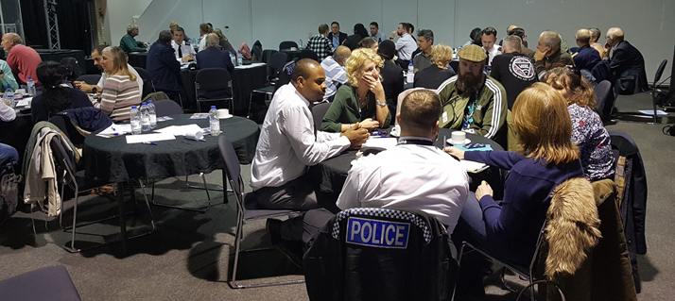
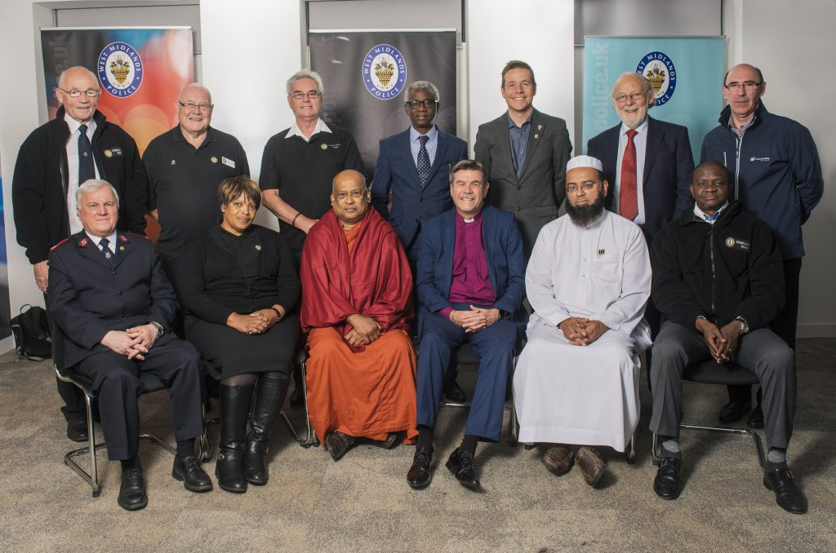
Faith and Police Together is more than just encouraging you to do community engagement, it’s about developing partnerships.
As relationships between faith communities and the police develop and trust and confidence increases, this can provide a range of opportunities
West Midlands Police
Chaplaincy Team
Notes:
We the Police need to see Faith Communities as potential key stake holders at the partnership table to help solve local problems. Faith Communities are not going to be able to solve them all but they will be able to help with many. Community problems need community answers. Faith and Police together is about more than just encouraging you to do community engagement, it’s about developing partnerships.
The most successful cross-sector partnerships are those which offer mutual benefits and where there are shared values and common goals. However, successful partnerships take time to develop. Effective partnership working allows both faith-based organisation and their partners to maximise scarce resources, avoids duplication of services and provides services that are better able to meet the often complex and multiple needs. Effective partnerships can result in greater impact and value for money, we know this for statutory bodies but we must not miss out our faith communities.
Faith Communities can help support the Police and other statutory agencies in numerous ways by engaging with and supporting some of the most vulnerable within our communities both in reactive and proactive preventative initiatives, reducing vulnerability, meeting the individuals needs and in turn potentially reducing offending, crime, and demand all of which has a significant positive impact on the community.

Slide 13
Summary
Find out who your Faith Communities are and what they are doing.
Building meaningful relationships with them.
Share needs / problems with them
Consider your Faith Communities as a partner to help with Problem solving
Share best practice
Notes:
You should now be able
Find out who your Faith Communities are and what they are doing.
Building meaningful relationships with them.
Share needs / problems with them
Consider your Faith Communities as a partner to help with Problem solving
Share best practice

Slide 14
For further information and to download the Faith Communities Guide to Engaging with Police visit
www.faithandpolicetogether.org.uk
Or the NPCC Neighbourhood policing Knowledge Hub.
https://knowledgehub.group/group/modernising-neighbourhood-policing
Twitter: @FaithAndPolice
#FaithAndPoliceTogether
Marie.Reavey@Norfolk.police.uk

